Slide 1

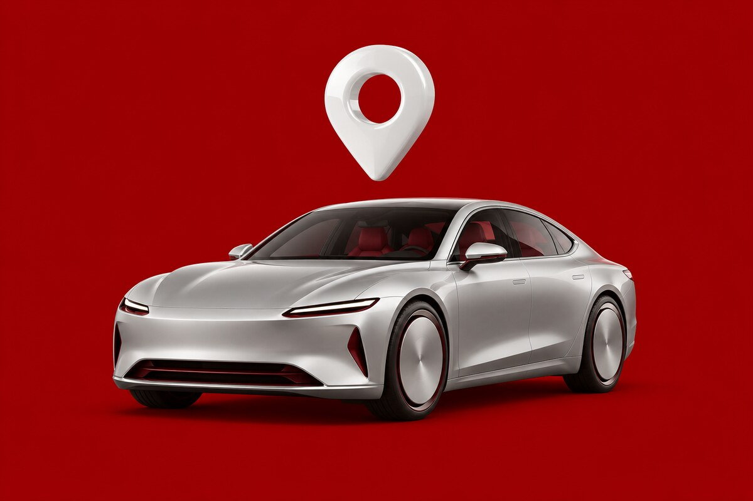
FOR RENTAL COMPANIES AND CAR OWNERS
Rent out more cars.
With less work.
Join YorDrive, the car-rental marketplace for Jordan. We bring the customers. You run the cars.
Confidence, every mile.
بثقة، في كل مشوار
Notes:
YorDrive is a car-rental marketplace for Jordan. This short guide shows rental companies and private car owners how YorDrive brings them more bookings with less work.

Slide 2

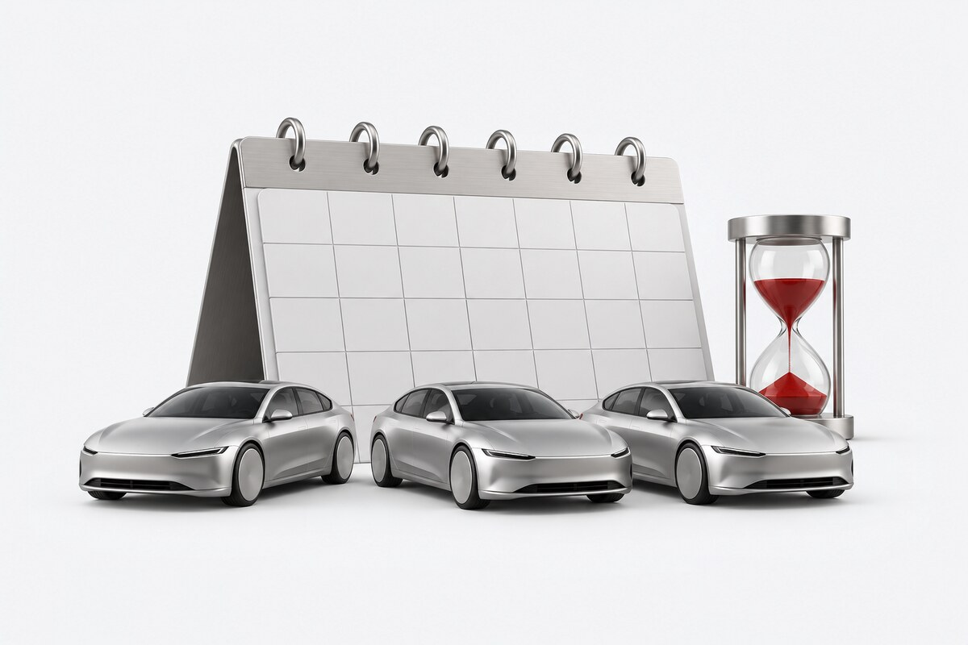




THE PROBLEM
Renting cars is hard work today
Most rental offices run on phone calls and WhatsApp. That makes it hard to grow.
Cars wait on quiet days
A car in the lot earns nothing, but you still pay for it.
Bookings get lost
Calls, WhatsApp and paper notes are hard to track. Mistakes happen.
No-shows cost you the day
A customer cancels late or never comes, and the car stays empty.
Hard to be found online
Ads and a website take time and money that small offices don't have.
02 / 22
Notes:
Most rental offices in Jordan run on phone calls and WhatsApp. Cars sit idle on quiet days, bookings get lost, late cancellations cost money, and getting found online is expensive.

Slide 3
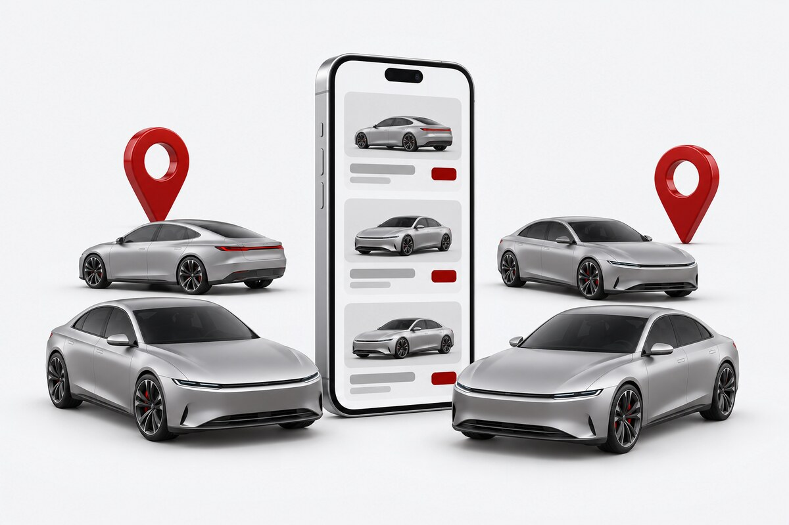
WHAT IS YORDRIVE
One place where Jordan rents cars
Customers find, compare and book cars from many partners. You get the bookings.
Rental companies
List your fleet: self-drive or with a driver, daily or monthly. Every branch, every car.
Private car owners
Rent your own car with you or your driver at the wheel, and earn on your free days.
Customers
Locals and visitors book on the website or the iPhone app, in Arabic or English.
03 / 22
Notes:
YorDrive is one marketplace: many partners, one place for customers. Companies rent self-drive or with a driver, daily or monthly. Private owners rent with a driver. Customers book on the website or the iPhone app.

Slide 4
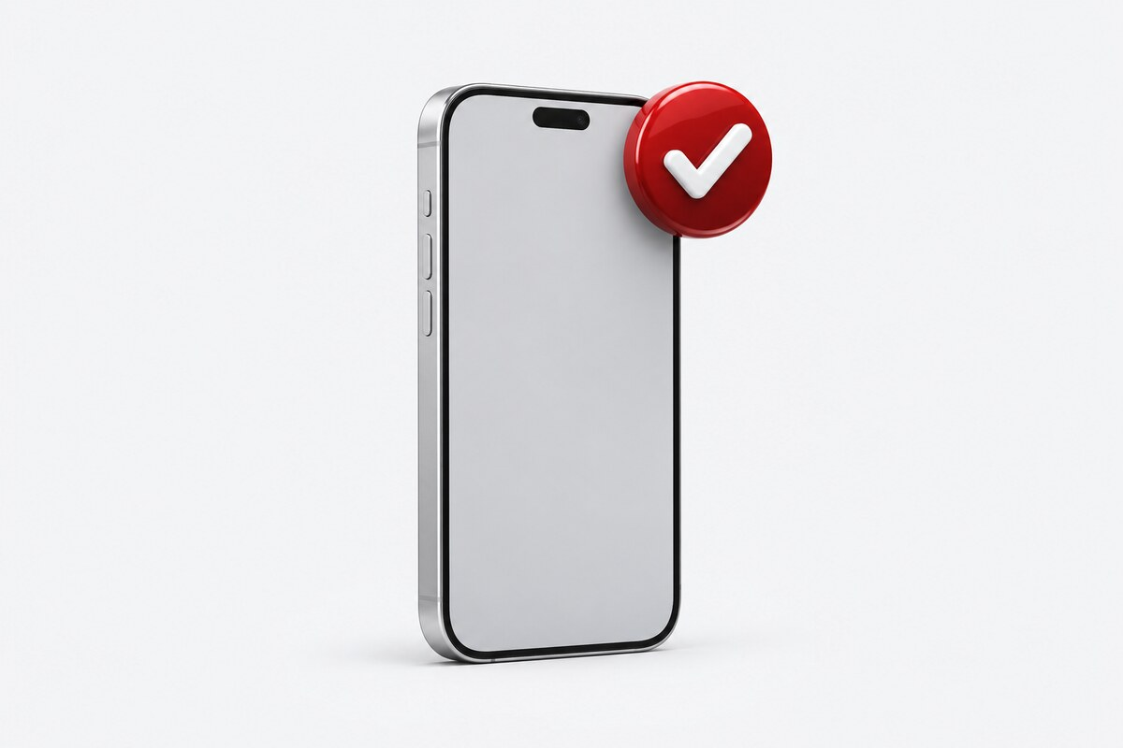
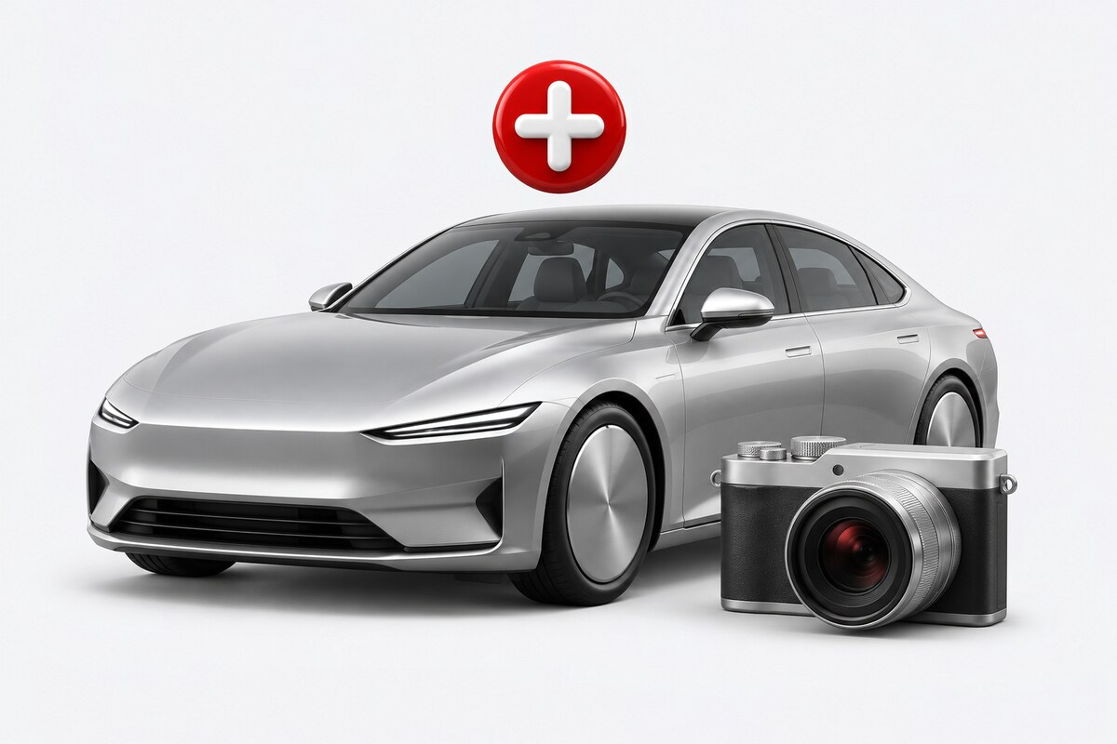


HOW IT WORKS
Four simple steps
From sign-up to your first booking. No technical skills needed.
1
2
3
4
Sign up
List your cars
Get bookings
Get paid
Sign up with your phone number and send your papers.
Add each car with photos, prices and your rules.
Customers book. You accept, or use instant book.
The customer pays the rest to you at pickup.
04 / 22
Notes:
Four steps. Sign up with a phone number and send your papers. List each car. Customers book and you accept, or the booking confirms instantly where instant book is on. The customer pays a small part online and the rest to you at pickup.

Slide 5





BENEFIT 1 · MORE BOOKINGS
More customers see your cars
When someone looks for a car in Jordan, your cars are right there.
Seen across Jordan
Your cars show in every search that matches them.
Easy to find
Customers filter by city, dates, car type and price, then book.
Found on Google and AI search
Each car gets its own page that search engines can read.
Stand out
Paid plans can feature your cars at the top, marked Sponsored.
05 / 22
Notes:
Your cars appear in every matching search across Jordan. Customers filter by city, dates, car type and price. Every car gets its own page that Google and AI search engines can read. Paid plans can feature cars at the top, clearly marked Sponsored.

Slide 6


BENEFIT 2 · PARTNER DASHBOARD
Run your whole business in one place
One simple dashboard replaces the notebook, the spreadsheet and the phone calls.
Fleet
Bookings
Every car and every unit
Accept, check in, check out
Calendar
Branches
Every car's days at a glance
Hours, cars and delivery zones
Staff
Drivers
Owner, manager, agent roles
Papers, languages and tasks
On your computer and on your phone
06 / 22
Notes:
The partner dashboard runs the whole business: the fleet, bookings with digital check-in and check-out, a calendar for every car, branches with hours and delivery zones, staff with roles, and drivers with their papers and languages. It works on a computer and installs on a phone.

Slide 7





BENEFIT 3 · PRICING CONTROL
You set your own prices
Your cars, your prices, your rules. Change them any time from the dashboard.
Daily and monthly prices
Set cheaper rates for longer stays, if you want.
Your extras
Driver, delivery, extra driver and other options, at your price.
Your rules
Mileage, deposit, fuel and minimum days: you decide.
Clear for customers
They see the full price before they pay. No card surcharges.
07 / 22
Notes:
You set your prices: daily and monthly, with cheaper rates for longer stays if you want. You price your own extras and set your own rules for mileage, deposit, fuel and minimum days. Customers see the full price before they pay, and there are no card surcharges.

Slide 8

BENEFIT 4 · REQUEST TO BOOK
You say yes. Then the money moves.
Every booking is safe for both sides: the money is ready before you confirm.
1
Customer taps Pay
The card is held, not charged.
2
You accept
The held amount is taken. The booking is confirmed.
3
You decline, or time runs out
The hold is released. No refunds to chase.
Cars always ready? Use instant book, where your plan allows it.
08 / 22
Notes:
With request to book, the customer's card is only held when they tap Pay. When you accept, the money is captured and the booking is confirmed. If you decline or the response time runs out, the hold is simply released, so there are no refunds to chase. Cars that are always ready can use instant book where the plan allows it.

Slide 9



BENEFIT 5 · PAYOUTS AND STATEMENTS
Clear money, paid to your bank
You always know what you earned, what we took, and when you get paid.
Most money comes at pickup
The customer pays you directly: cash, card, CliQ or a payment link.
Monthly payouts
Your YorDrive balance goes to your bank (IBAN) or CliQ every month.
Payout on request
Need it sooner? Ask for a payout any time from the dashboard.
A statement every month
Every booking, fee and payout. Download as PDF, Excel or CSV.
09 / 22
Notes:
Most of the money comes to you at pickup, by cash, card, CliQ or a payment link, as you choose. The online part, after commission, goes to your YorDrive balance and is paid monthly to your bank account or CliQ. You can also ask for a payout any time. Every month you get a statement with every booking, fee and payout.

Slide 10

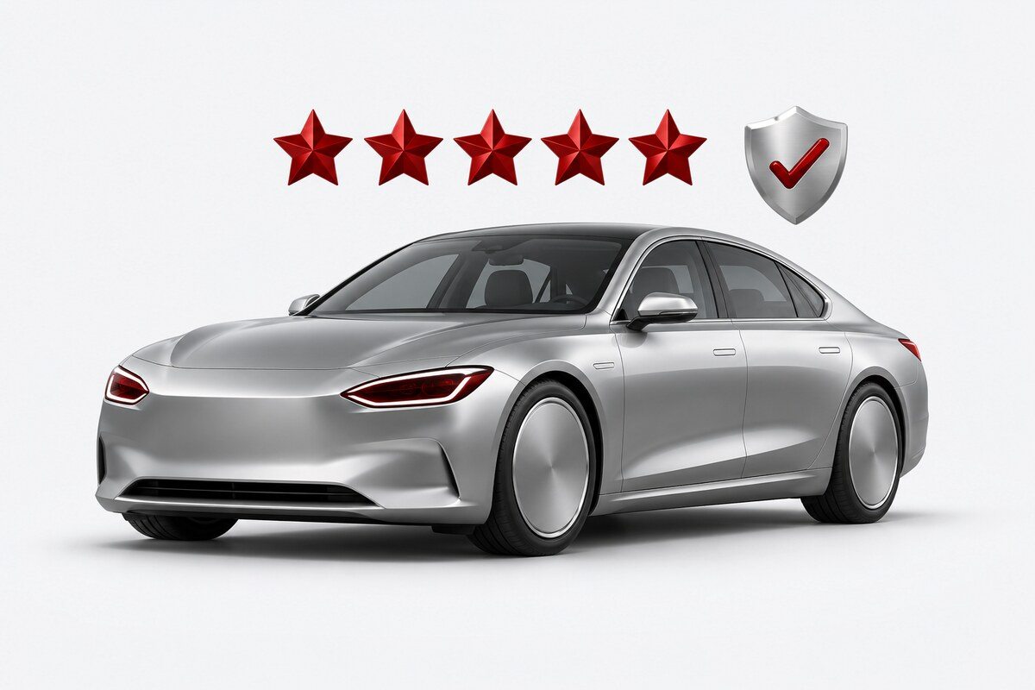


BENEFIT 6 · REVIEWS AND TRUST
Good service builds your name
Happy customers leave reviews. Good reviews bring more customers.
Real reviews only
Only customers who finished a trip can leave a review.
Three ratings
The company, the car and the driver, after every trip.
Reply to every review
Answer in public and show customers that you care.
Fair both ways
You rate customers too, privately, so bad customers are known.
10 / 22
Notes:
After each trip, customers rate the company, the car and the driver. Only customers who finished a real trip can review. You can reply to every review, and you rate customers too, privately. Good service builds your score and your name.

Slide 11



BENEFIT 7 · WEBSITE AND IPHONE APP
Customers book in Arabic or English
A modern website and iPhone app that make booking your car quick and easy.
Website and iPhone app
The same cars and the same prices on both.
Arabic and English
Full right-to-left Arabic on every screen, and full English.
Light and dark mode
Easy to read, day or night, on any phone.
Fast checkout
Two steps to book, with Apple Pay or a card.
11 / 22
Notes:
Customers book on a full website and an iPhone app, with the same cars and prices on both. Every screen works in Arabic, right to left, and in English, in light and dark mode. Booking takes two steps, with Apple Pay or a card.

Slide 12
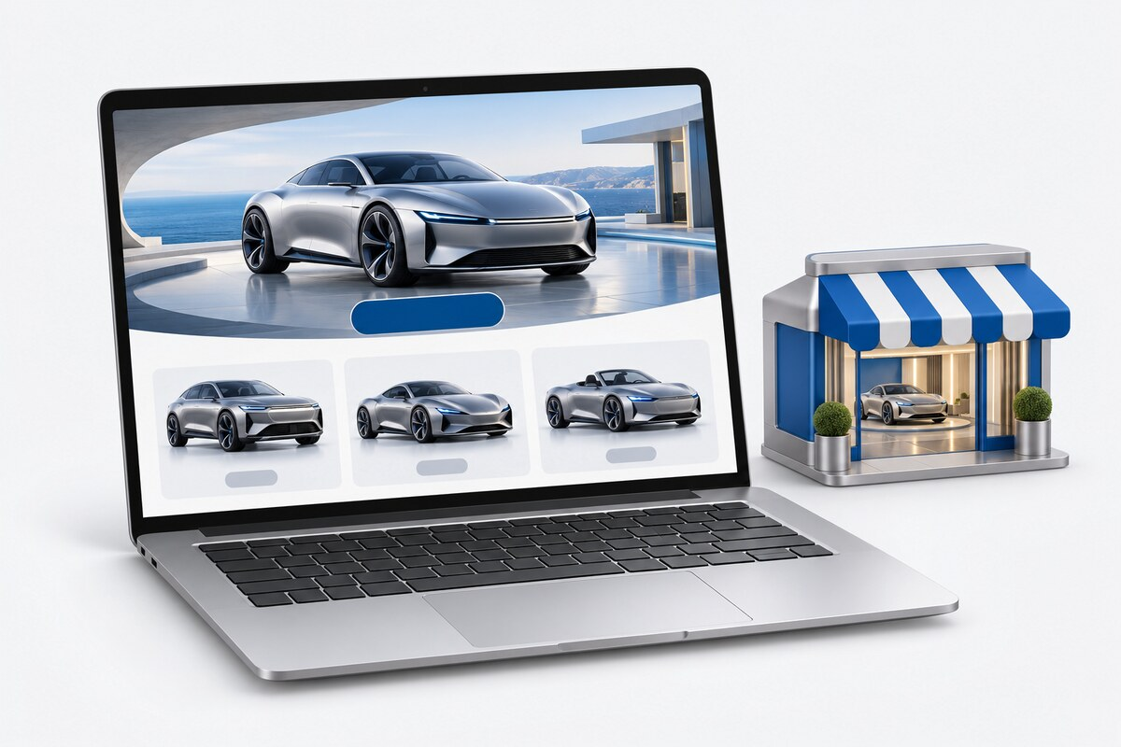
BENEFIT 8 · YORDRIVE BUSINESS
Your own booking website
For rental companies: your own website, with your brand. Paid plans with a free trial.
Your brand
Your logo, colours, photos and pages.
Your address
yourname.yordrive.com or your own domain.
Your money, your choice
Use your own payment gateway, or let YorDrive collect.
Simple guest booking
Car and dates, then name and phone, then one code.
With or without the marketplace
Choose per car where it is listed, and its price.
12 / 22
Notes:
YorDrive Business gives a rental company its own booking website with its own brand, on a yordrive.com subdomain or its own domain. The company can use its own payment gateway, so the money goes straight to it, or let YorDrive collect. Guests book in three steps. It works with the marketplace or on its own, and the company chooses per car where it is listed and at what price.

Slide 13



SECURITY AND SAFETY
Safe for you, your cars and your money
Every person, car and payment is checked, so you can rent with confidence.
Verified partners and cars
Verified customers
Every partner, car and driver is checked.
Phone-code sign-in and driver checks.
Fraud checks
Private contacts
Risky payments are stopped before they start.
Phone numbers show only after confirmation.
Digital check-in and out
Fair disputes
Photos and signatures at pickup and return.
Deposits and charges are kept with evidence.
13 / 22
Notes:
Every partner, car and driver is verified. Customers sign in with a phone code and drivers are checked. Fraud checks stop risky payments. Phone numbers are shared only after a booking is confirmed. Pickup and return use digital check-in and check-out with photos and signatures, and deposits and charges keep their evidence.

Slide 14




CUSTOMER REACH
Customers from Jordan and abroad
We start in Amman and Queen Alia Airport. Aqaba comes next.
Jordanians abroad
Home for the summer. Long rentals, family cars.
Gulf visitors
Summer and Eid holidays. SUVs and cars with a driver.
Western tourists
Spring and autumn road trips to Petra and Wadi Rum.
Residents
All year: weekends, weddings, a car during repairs.
Monthly renters
Expats, NGO and company staff. One to twelve months.
14 / 22
Notes:
We launch in Amman and Queen Alia Airport, with Aqaba next. Customers come from Jordan and abroad: Jordanians home for the summer, Gulf visitors, Western tourists, residents all year round, and monthly renters such as expats and company staff.

Slide 15



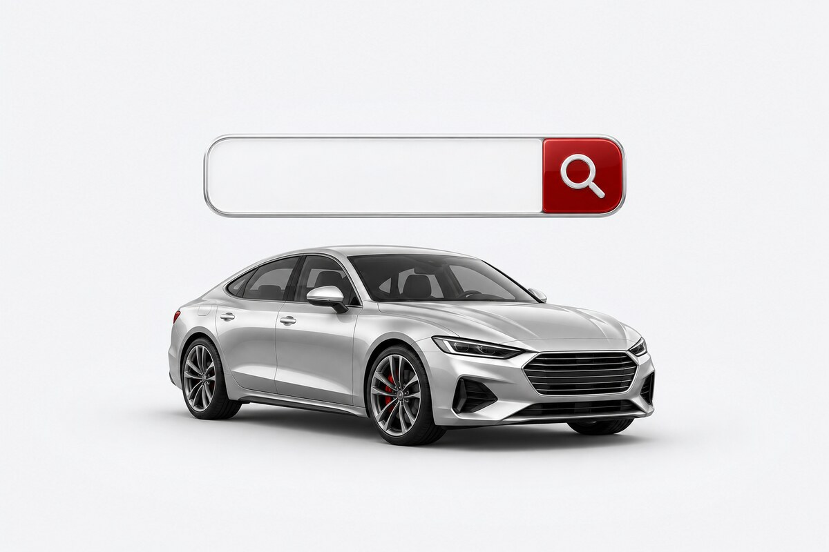

MARKETING · CHANNELS 1 TO 5
10 channels bring customers to you
We run the marketing, and it is included. Here are the first five: online and in the media.
1
2
3
4
5
Social media
Media and press
Influencers
Google search
SEO and AI search
Facebook, Instagram and TikTok ads for people in Jordan and abroad.
News, TV, radio and launch events tell people about YorDrive.
Travel creators share real trips: Petra, Wadi Rum, the Dead Sea.
People who search "car rental Amman" in Arabic or English find us.
Pages for every city and car type, shown by Google and AI assistants.
15 / 22
Notes:
We run about ten marketing channels, and our marketing is included: partners pay nothing extra for it. The first five are online and in the media: social media campaigns, the press, travel creators, Google search, and search pages that Google and AI assistants read.

Slide 16





MARKETING · CHANNELS 6 TO 10
Travel trade and big clients
Five more channels bring bigger and longer bookings through our partners.
6
7
8
9
10
GDS and aggregators
Travel companies
Corporate partners
Hotels and airport
WhatsApp and the app
Global booking systems and comparison sites bring tourists from abroad.
Travel agencies and tour operators book cars for their travellers.
Companies and NGOs rent cars for staff and visitors, often monthly.
Hotels send their guests to us. Partners meet customers at the airport.
Offers to customers who opted in. The iPhone app brings them back.
16 / 22
Notes:
Channels six to ten come through partners: global booking systems and travel comparison sites, travel agencies and tour operators, companies and NGOs that rent cars for staff and visitors, hotels and Queen Alia Airport, and WhatsApp offers plus the iPhone app that bring customers back.

Slide 17
SIMPLE COSTS
You pay only when you earn
No booking, no cost. We earn a commission only when a customer books your car.
Free
Free
Commission
EXAMPLE BOOKING
to join
to list your cars
only on bookings
3 days × 25 JOD = 75 JOD
Plan
Plan fee
Daily rentals
Monthly rentals
Customer pays online now
Basic
Free
15%
10%
11.250 JOD
Pro
Companies: 19 JOD a month
Private owners: 5 JOD a month
12%
9%
YorDrive's commission (15%)
Customer pays you at pickup
Pro Plus
Companies: 49 JOD a month
10%
8%
63.750 JOD
Launch defaults for Jordan, set per market. Minimum commission 2 JOD per booking. YorDrive pays the card fees. Paid plans open at public launch; until then, new partners join as Founding partners.
Plus a refundable deposit, paid to you
17 / 22
Notes:
Joining and listing are free. YorDrive earns a commission only on bookings you get, with a minimum of 2 JOD per booking. Basic is free: 15 percent on daily rentals and 10 percent on monthly rentals. Optional paid plans lower the commission. These are the launch defaults for Jordan and are set per market. In the example, a 75 JOD rental: the customer pays 11.250 JOD online, which is the commission, and pays you 63.750 JOD at pickup.

Slide 18

ONBOARDING
Start in five easy steps
Joining is simple, and our team helps you at every step.
1
Sign up with your phone
One code by SMS or WhatsApp. No password to remember.
2
Choose your type
Rental company, or private car owner.
3
Send your papers
Your company papers, or your ID and licence. We tell you which ones.
4
We check and approve
Our team reviews your papers and helps if something is missing.
5
Add your cars
Each car is checked with its registration, then goes live.
18 / 22
Notes:
Getting started takes five steps: sign up with a phone code, choose rental company or private car owner, upload your papers, we review and approve, then add your cars. Companies send their commercial registration, rental licence and the signer's ID. Private owners send their ID, driving licence and a no-criminal-record certificate. Each car is checked with its registration before it goes live.

Slide 19


SUPPORT
We help you every step
Real people who speak your language, and clear guides inside the dashboard.
Arabic and English support
Talk to us on WhatsApp, or open a ticket from the dashboard.
Help inside the dashboard
The help link on each screen opens the right guide.
Help to set up
Founding partners get free setup and a photo session for their cars.
A named contact
Pro Plus partners get their own account manager.
19 / 22
Notes:
Support works in Arabic and English, on WhatsApp or by ticket. Every dashboard screen has a help link to the right guide. Founding partners get free setup help and a photo session, and Pro Plus partners get an account manager.

Slide 20

QUESTIONS
Questions partners ask
Short answers to what partners ask us most.
Does it cost money to join?
Who sets the prices?
Can I say no to a booking?
No. Joining and listing are free. You pay commission only on bookings.
You do, for every car and every season.
Yes. The card is only held until you accept. Decline, and the hold is released.
What if a customer doesn't show up?
Can a private car owner join?
When do I get my money?
The online payment is kept, and you get your share of it.
Yes. You rent your car with you or your driver at the wheel.
Most of it at pickup. The rest goes to your bank or CliQ every month.
20 / 22
Notes:
The questions partners ask most. Joining is free. You set the prices. You can decline a request and the hold is released. If a customer does not show up, the online payment is kept and you get your share. Private owners can join and rent with a driver. Most money comes at pickup, the rest monthly.

Slide 21




WHY JOIN NOW
Become a Founding partner
A special offer for the first partners, before public launch.
0 JOD
12%
Locked
plan fee for the first 6 months
commission on daily rentals (9% monthly)
Pro price for 12 months after that
Pro benefits: badge, featured cars, instant book
Free setup help and a photo session
Places are limited
21 / 22
Notes:
Before public launch, new partners join as Founding partners. No plan fee for six months, then the Pro price locked for twelve months. Lower commission: 12 percent daily and 9 percent monthly. Pro benefits, plus free setup help and a photo session. Places are limited.

Slide 22
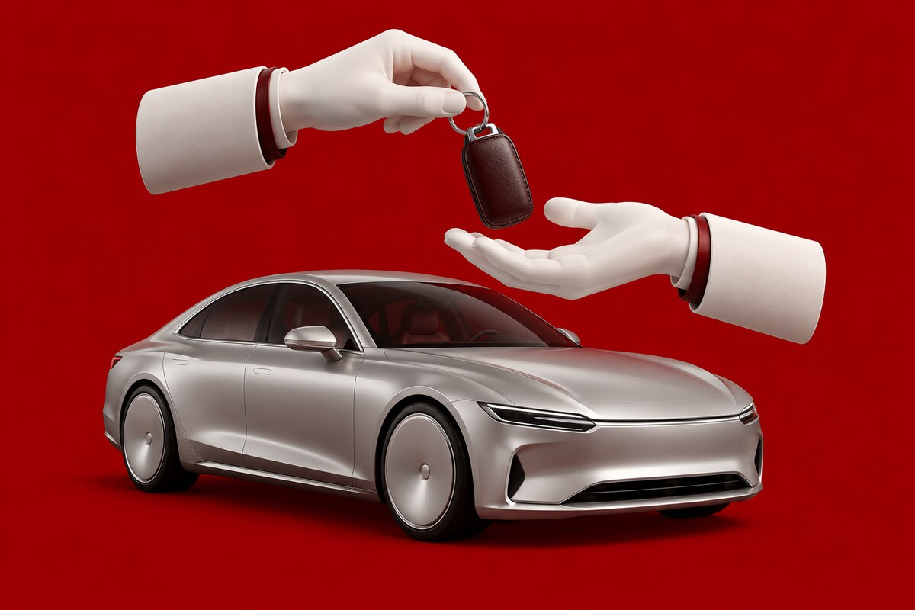
JOIN US
Join YorDrive today
More bookings. Less work. Money you can see.
1
Contact us
2
Sign up
3
List
by phone, WhatsApp or email
we help you send your papers
your first car
OUR OFFICE
King Al Hussein St 60, Amman, Jordan
+962 7 9087 9419
Sunday to Thursday, 9:00 AM to 6:00 PM
Call or WhatsApp · info@netronsoft.com · yordrive.com
22 / 22
Notes:
Joining is easy: call, WhatsApp or email us, we help you sign up and send your papers, then you list your first car. Our team is there Sunday to Thursday, 9 AM to 6 PM.

